Slide 1
Sentiment Analysis on Amazon Reviews
By Krushal Kalkani

Slide 2
Objective
Sentiment analysis to classify Amazon reviews.
Improving products and customer satisfaction.

Slide 3
Dataset Overview
Amazon Customer Reviews Dataset
Size: 2 million reviews.
Variables: Polarity (positive/negative), Title, Text.

Slide 4
Exploratory Data Analysis (EDA)
Sentiment distribution: 60% positive, 40% negative.
Review length distribution: Most reviews are 100–300 characters.
Common words in positive and negative reviews:
Positive: "great," "love."
Negative: "bad," "disappointing."

Slide 5
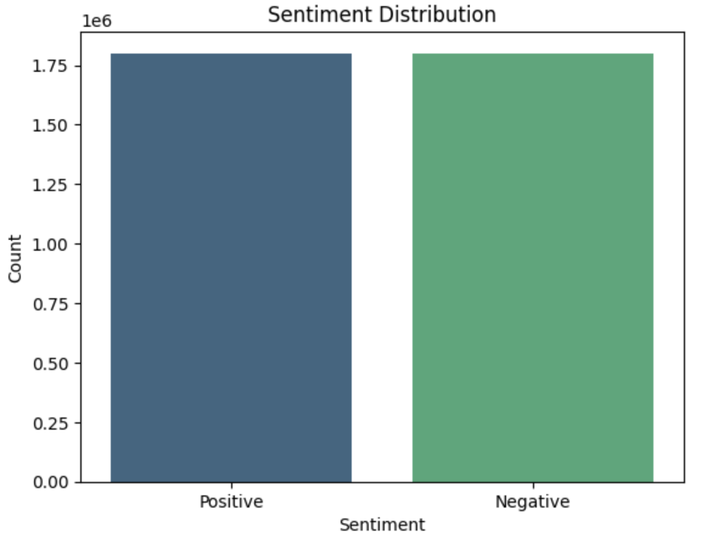

Slide 6
Data Preprocessing
Handled missing values (none in the text column).
Removed special characters, stopwords, and converted text to lowercase.
Tokenized and vectorized text using TF-IDF.

Slide 7
Feature Engineering
Extracted review_length as a new feature.
Applied TF-IDF vectorization with max_features=1000.
Importance of these features in improving model performance.

Slide 8
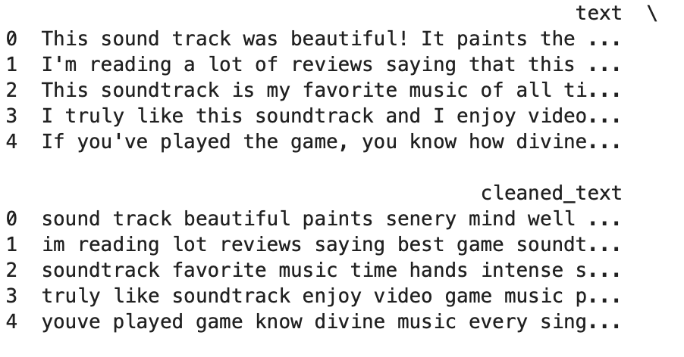

Slide 9
Model Building
Logistic Regression: Simple and efficient.
Decision Tree Classifier: Captures complex patterns but prone to overfitting.
Split dataset: 80% training, 20% testing.

Slide 10
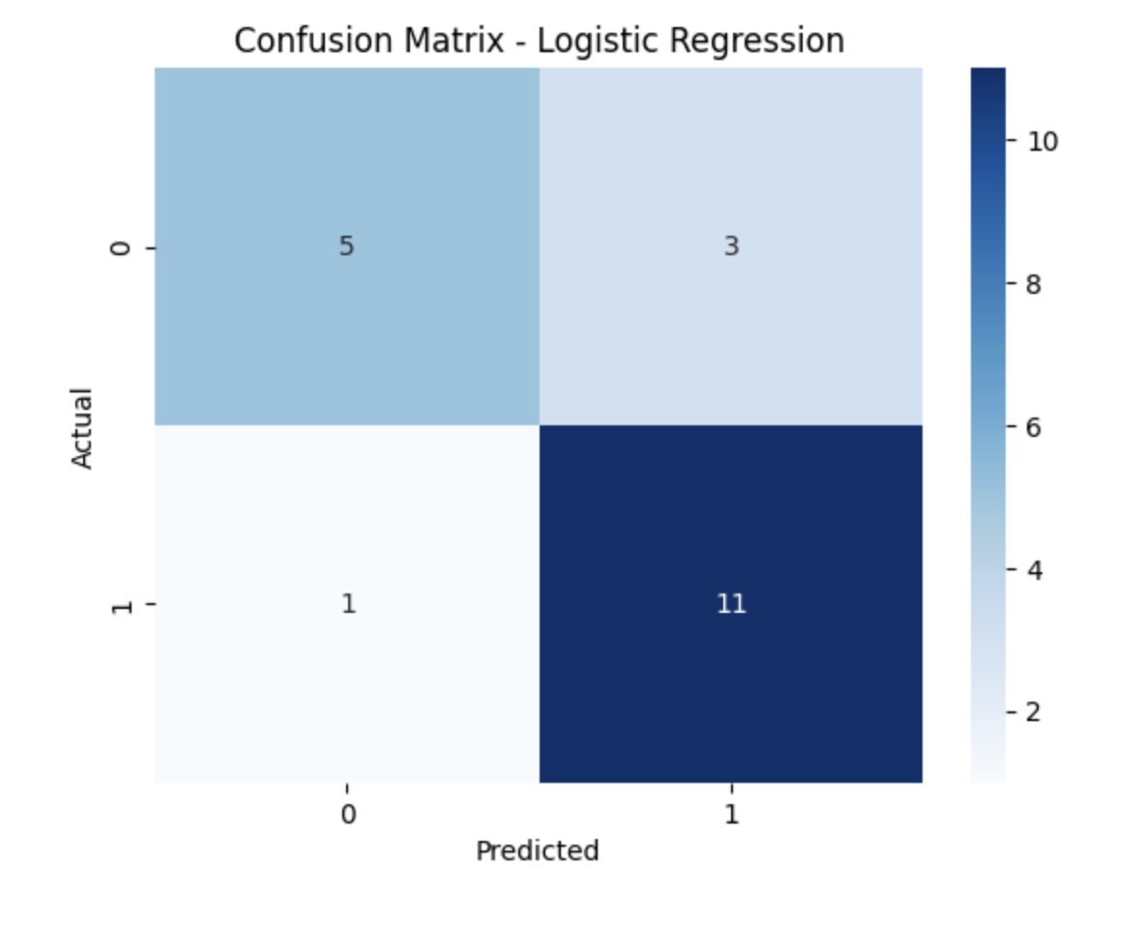

Slide 11
Model Evaluation
Logistic Regression Accuracy: 85%.
Decision Tree Accuracy: 80%.
Confusion Matrix Insights:
True Positives/Negatives: Correctly classified reviews.
False Positives/Negatives: Misclassified reviews.

Slide 12
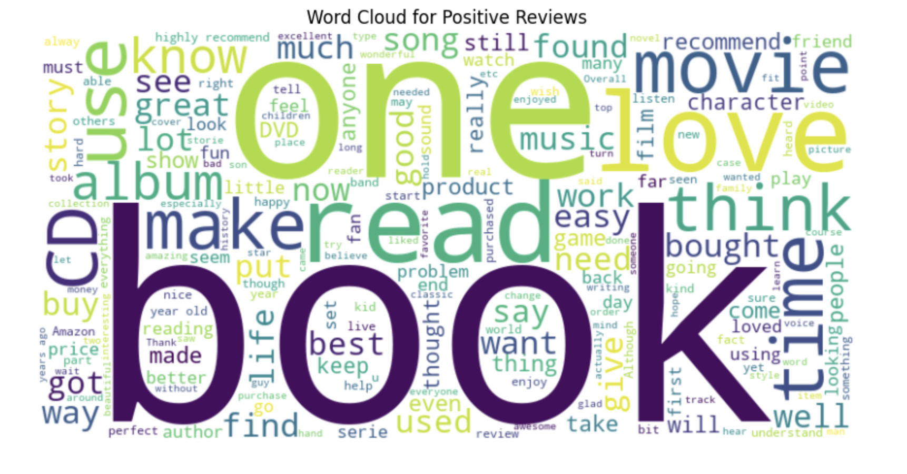

Slide 13
Business Insights
Positive reviews highlight overall customer satisfaction.
Negative reviews provide actionable feedback.
Top issues: "bad," "poor," and "disappointing."

Slide 14
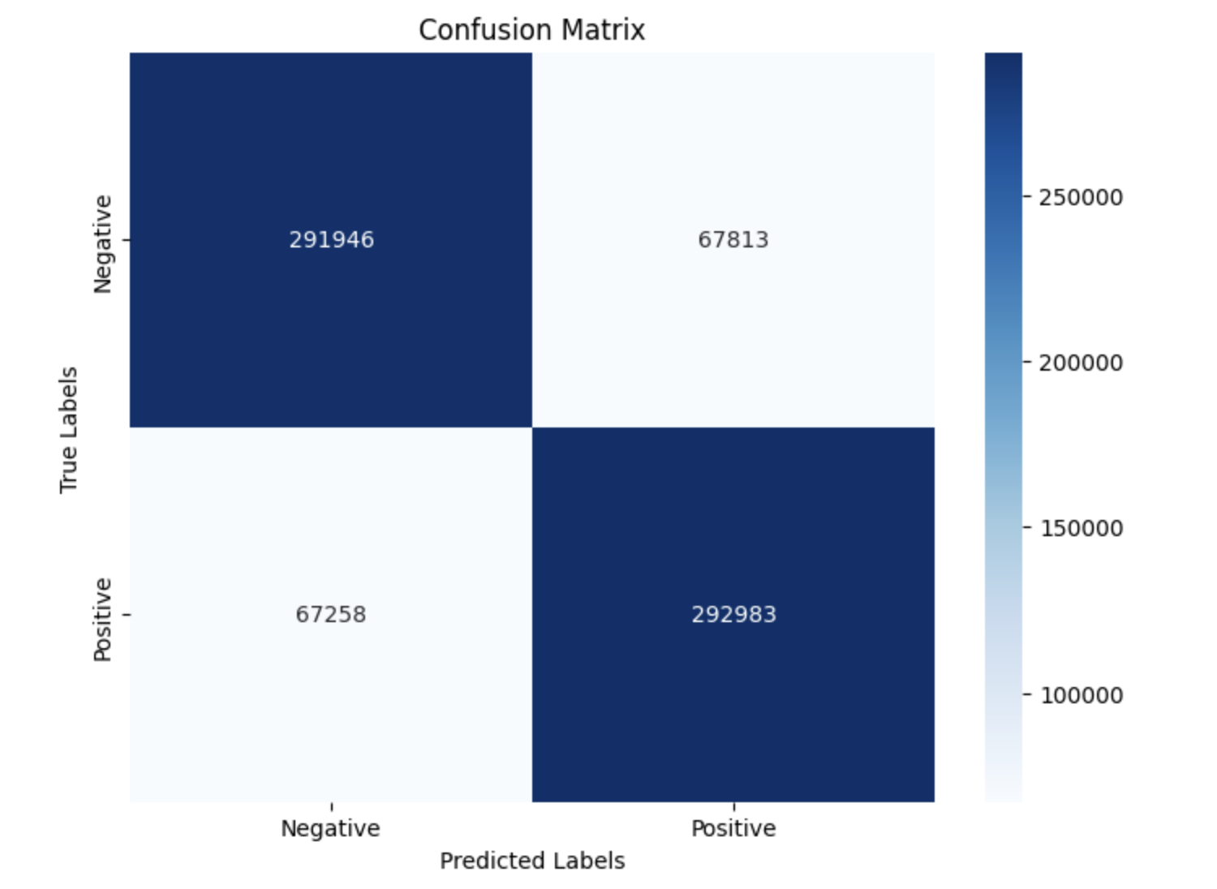

Slide 15
Conclusion
Business impact: Improve product offerings and enhance customer support.
Future work: Explore advanced models and deploy the system.

Slide 16
Thank You

